Slide 1
Data Transfer and Addressing
Lecture 3

Slide 2
Contents
Data Transfer
Data Declaration
Addressing Modes
Direct
Indirect

Slide 3
Data Transfer
The MOV instruction copies data from a source operand to a destination operand.
Known as a data transfer instruction, it is used in virtually every program.
Its basic format shows that the first operand is the destination and the second operand is the source:
MOV destination,source
It is equivalent to destination= source; in any high level language like in java or C++

Slide 4
Rules for MOV instruction
MOV is very flexible in its use of operands, as long as the following rules are observed:
Both operands must be the same size.
Both operands cannot be memory operands.
The instruction pointer register (IP) cannot be a destination operand.

Slide 5
MOV instruction formats
Here is a list of the standard MOV instruction formats:
MOV register, register
MOV register, immediate operand
MOV memory, register
MOV register, memory
MOV memory, immediate operand

Slide 6
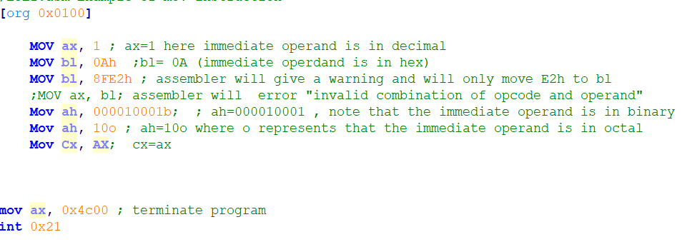
Examples
Notes:
;L3E1.asm Example of mov instruction
[org 0x0100]
MOV ax, 1 ; ax=1 here immediate operand is in octal
MOV bl, 0Ah ;bl= 0A (immediate operdand is in hex)
MOV bl, 8FE2h ; assembler will give a warning and will only move E2h to bl
;MOV ax, bl; assembler will error "invalid combination of opcode and operand"
Mov ah, 000010001b; ; ah=000010001 , note that the immediate operand is in binary
Mov ah, 10o ; ah=10o where o represents that the immediate operand is in octal
Mov Cx, AX; cx=ax
mov ax, 0x4c00 ; terminate program
int 0x21

Slide 7
Data Declaration
Up till now we were either working with registers or immediate operands.
Every reasonable program will require storing and retrieving data from memory.
Because registers are limited and or immediate operands need hardcoding

Slide 8
Data Declaration
Data can be declared using following instruction
<label>: <db/dw/dd> <values/s>
db will define a byte
dw will define a word (2 bytes)
dd will define double word (4 bytes)
Label is used by programmers to refer to the data again. Its like name of variable as used in HLL.
The size of data is not associated with label.
As a result a cell in memory will be reserved containing the desired value in it and it can be used in a variety of ways.

Slide 9
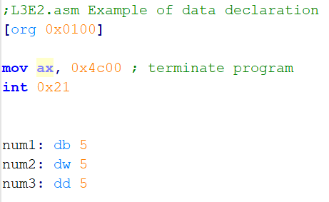
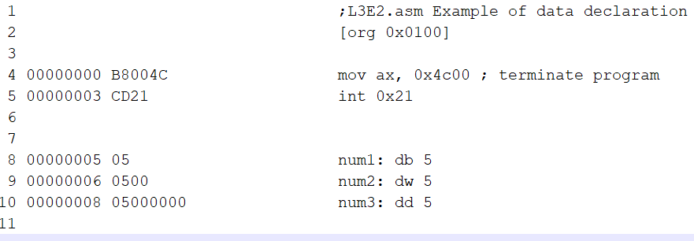
Data Declaration Examples
Following is the code and listing file of declaring on db , one dw and on dd type
The data is declared below the code
Note the labels num1, num2 and num3 appear nowhere in the machine code, they are symbol for us but an address for the processor while the conversion is done by the assembler.
Notes:
;L3E2.asm Example of data declaration
[org 0x0100]
mov ax, 0x4c00 ; terminate program
int 0x21
num1: db 5
num2: dw 5
num3: dd 5

Slide 10
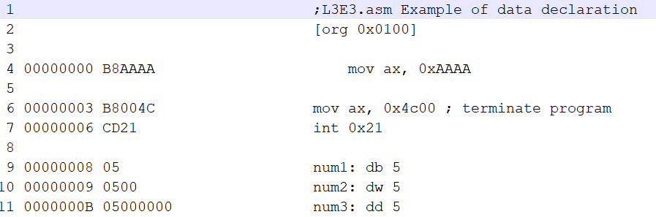
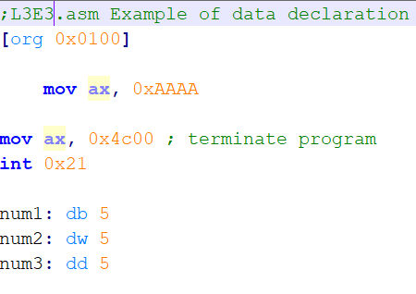
Data Declaration More examples
This example shows the assembly code and listing file
Notes:
;L3E3.asm Example of data declaration
[org 0x0100]
mov ax, 0xAAAA
mov ax, 0x4c00 ; terminate program
int 0x21
num1: db 5
num2: dw 5
num3: dd 5

Slide 11
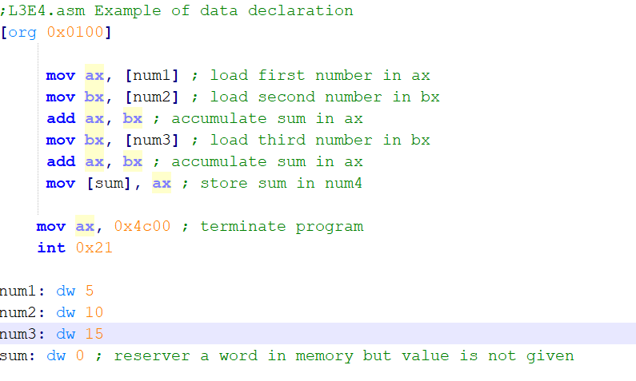
Moving data to/from memory
We will see with an example to add three numbers, present in memory, and store the result again in memory.
Code is given below, note that label is written in square brackets
The bracket is signaling that the operand is placed in memory at address num1.
Notes:
;L3E4.asm Example of data declaration
[org 0x0100]
mov ax, [num1] ; load first number in ax
mov bx, [num2] ; load second number in bx
add ax, bx ; accumulate sum in ax
mov bx, [num3] ; load third number in bx
add ax, bx ; accumulate sum in ax
mov [sum], ax ; store sum in num4
mov ax, 0x4c00 ; terminate program
int 0x21
num1: dw 5
num2: dw 10
num3: dw 15
sum: dw 0 ; reserver a word in memory but value is not given

Slide 12
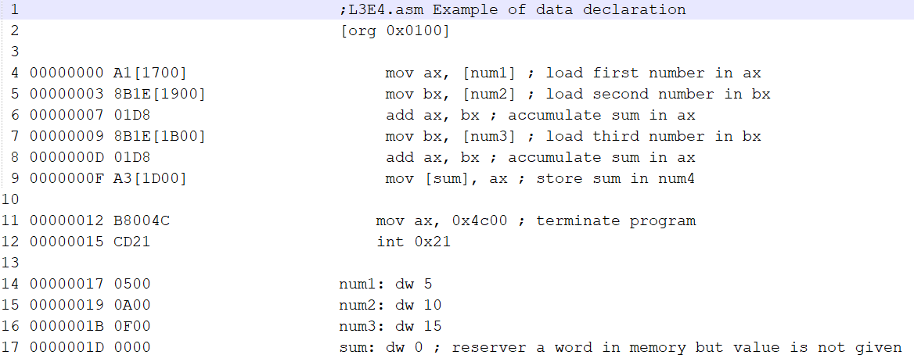
Example cont… listing file
The size of the code is 17 bytes and from 17th to 1D byte the data is located
Note the opcodes
The assembler has calculated the offset of num1 and used it to replace references to num1 in the whole program.

Slide 13
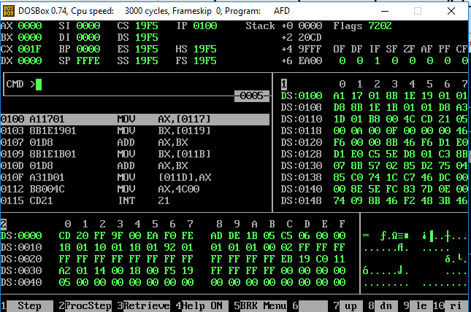
Example cont… in AFD
Before running
Notes:
Also observe that our naming of num1, num2, num3, and num4 is no longer there inside the debugger. The debugger is only showing the numbers 0117, 0119, 011B, and 011D

Slide 14
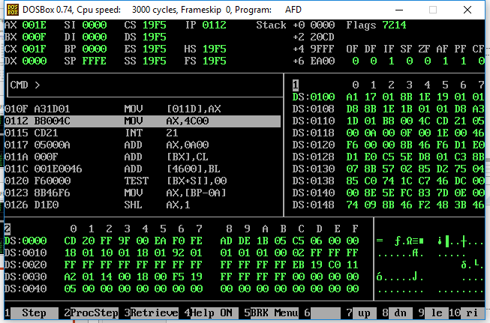
Example cont… in AFD
After running

Slide 15
Examples of mov to/from memory
Again note that the label is just one address in memory, there is no size associate with it.
How much data is to be moved to and from memory depends on the size of source.
Its is programmers responsibility to carefully read and write data in memory.
Following examples will explain each instruction in plain English.
mov [num1], ax ; move 2 bytes of register ax into memory, al will be placed at num1 address and ah will be placed at num1+1
mov [num1], al; move lower bytes of register ax into memory, at address num1
mov ax, [num1]; move 2 byte from memory to ax starting at address num1, byte at num1 will be moved to al and byte at num1+1 Will be moved to ah.
mov ah, [num1]; move 1 byte from memory to ah, starting from byte at num1
mov [num1], 5 ;will give an error as size of 5 is not known, instead use the following instructions
mov byte [num1], 5 ; move 5 to memory starting from address num1, where 5 is a 1 byte decimal number
mov word [num1], 5 ; move 5 to memory starting from address num1, where 5 is a 2 byte decimal number (word), 05 will be place on address num1 and 00 will be placed at address num1+1

Slide 16
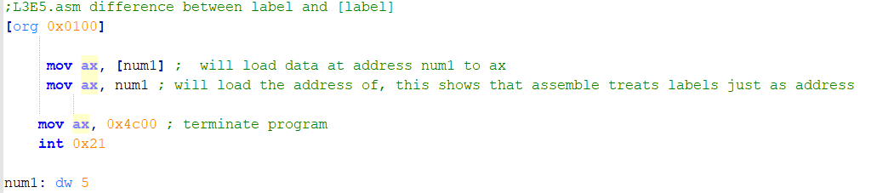
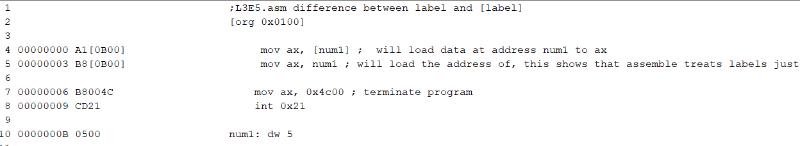
Difference between label and [label]
The difference is same as ptr and *ptr in c++
Notes:
;L3E5.asm difference between label and [label]
[org 0x0100]
mov ax, [num1] ; will load data at address num1 to ax
mov ax, num1 ; will load the address of, this shows that assemble treats labels just as address
mov ax, 0x4c00 ; terminate program
int 0x21
num1: dw 5

Slide 17

Other ways of declaring data (1)
Declaring more than one number using one label:
Following example create three numbers of size 2 bytes each and stores then contiguously in memory.
These there numbers can be accessed using label
[num+offset]
Where offset is distance of data from label nums in bytes
This is same as you did in C++ with pointers
the offset of 5 is 0, offset of 10 is 2, offset of 15 is 4

Slide 18
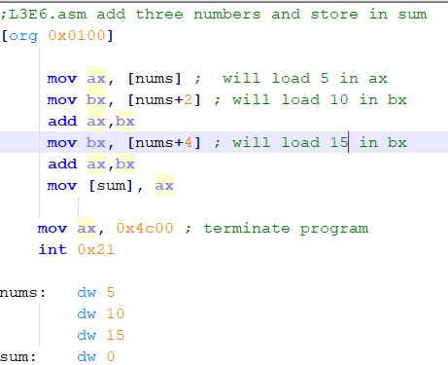
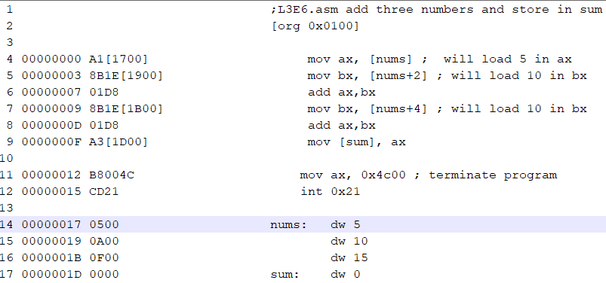
Example
Notes:
;L3E6.asm add three numbers and store in sum
[org 0x0100]
mov ax, [nums] ; will load 5 in ax
mov bx, [nums+2] ; will load 10 in bx
add ax,bx
mov bx, [nums+4] ; will load 15 in bx
add ax,bx
mov [sum], ax
mov ax, 0x4c00 ; terminate program
int 0x21
nums: dw 5
db 10
db 15
sum: dw 0

Slide 19

Note the data under same label can also be of different type
For example
The offset should be calculated accordingly.
Offset of 5 is 0, offset of 10 is 2, offset of 15 is 3.

Slide 20
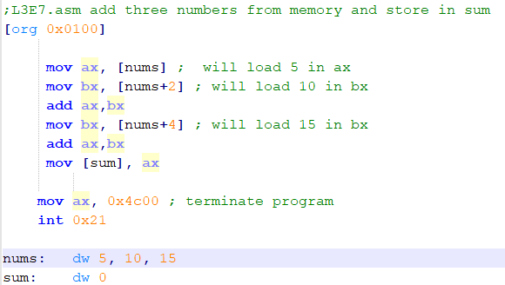
Other ways of declaring data (2)
Following example shows another way to store more than one number, of same type under same label.
Each number will be accessed in same way [label+offset].
Notes:
;L3E7.asm add three numbers from memory and store in sum
[org 0x0100]
mov ax, [nums] ; will load 5 in ax
mov bx, [nums+2] ; will load 10 in bx
add ax,bx
mov bx, [nums+4] ; will load 15 in bx
add ax,bx
mov [sum], ax
mov ax, 0x4c00 ; terminate program
int 0x21
nums: dw 5, 10, 15
sum: dw 0

Slide 21
Direct Addressing
The method of using label name (or memory address) in square brackets to access data from memory is called direct addressing.
[label] is used as operand is known as direct operand
[label+/- offset ] is used as operand is known as direct offset operand.

Slide 22
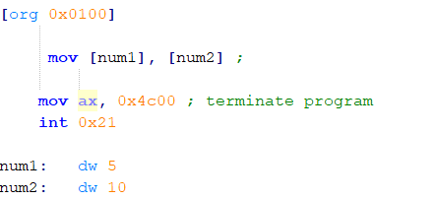
Question
Is there any error in following program? If yes, identify.

Slide 23
Question?
What will be effect of following instructions?
Mov ax, 0x0100
Mov ax, [0100]

Slide 24
Question
In which format data is written in memory?
Big endian
Little endian

Slide 25
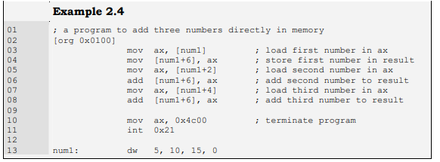
Example
Notes:
; a program to add three numbers directly in memory
[org 0x0100]
mov ax, [num1] ; load first number in ax
mov [num1+6], ax ; store first number in result
mov ax, [num1+2] ; load second number in ax
add [num1+6], ax ; add second number to result
mov ax, [num1+4] ; load third number in ax
add [num1+6], ax ; add third number to result
mov ax, 0x4c00 ; terminate program
int 0x21
num1: dw 5, 10, 15, 0

Slide 26
Size Mismatch Errors
The assembler allows the programmer to do everything he wants to do, and that can possibly run on the processor.
The assembler only keeps us from writing illegal instructions which the processor cannot execute. That is, it only checks the syntax errors not the logical
The programmer is responsible for accessing the data as word if it was declared as a word and accessing it as a byte if it was declared as a byte
Keeping that in mind, identify what is wrong in code given on next slide

Slide 27
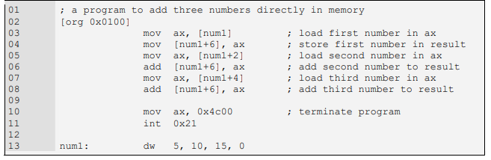
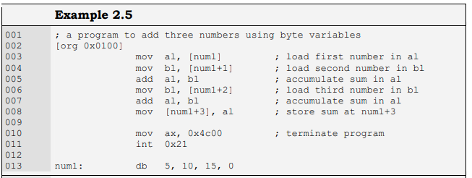
Identify the error

Slide 28
After Correction
Notes:
Removing anbiguties
Code
; a program to add three numbers using byte variables
[org 0x0100]
mov al, [num1] ; load first number in al
mov bl, [num1+1] ; load second number in bl
add al, bl ; accumulate sum in al
mov bl, [num1+2] ; load third number in bl
add al, bl ; accumulate sum in al
mov [num1+3], al ; store sum at num1+3
mov ax, 0x4c00 ; terminate program
int 0x21
num1: db 5, 10, 15, 0

Slide 29
Size Matching Error
The instruction “mov [num1], 5” is legal but there is no way for the processor to know the data movement size in this operation.
The variable num1 can be treated as a byte or as a word and similarly 5 can be treated as a byte or as a word.
Such instructions are declared ambiguous by the assembler.
Therefore to resolve its ambiguity we clearly tell our intent to the assembler in one of the following ways.
mov byte [num1], 5
mov word [num1], 5

Slide 30
Indirect Addressing
Direct addressing is rarely used for array processing because it is impractical to use constant offsets to address more than a few array elements.
Instead, we use a register as a pointer (called indirect addressing) and manipulate the register’s value.
When an operand uses indirect addressing, it is called an indirect operand

Slide 31
Register Indirect Addressing
When address is stored in register then register can be used as a pointer to that location in memory to access data
For example if bx= 0131h then following
Mov ax, [bx]
Will move 2 bytes starting at location 0131.
Note that the above instruction will actual move two bytes from memory to ax, byte located on 0131 will be transferred to al and byte on 0132 will be transferred to ah. (because data in memory is stored in little endian format)

Slide 32
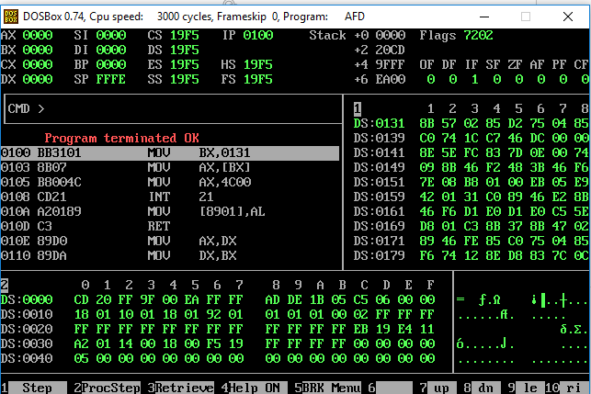
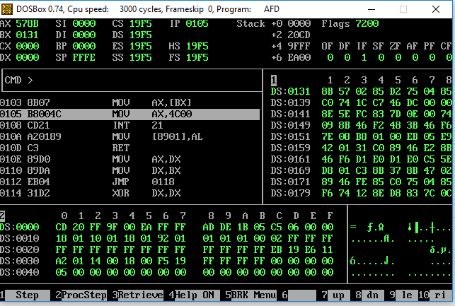
Register Indirect Addressing Example
Before running After running line 1 and 2
Notes:
[org 0x0100]
mov bx, 0131h
mov ax, [bx] ;
mov ax, 0x4c00 ; terminate program
int 0x21

Slide 33
Register Indirect Addressing cont..
There are four registers in iAPX88 architecture that can hold address of data and they are BX, BP, SI, and DI.
There are minute differences in their working which will be discussed later.
Lets see an example of adding numbers in loop using register indirect addressing.
The given examples is for 4 numbers, but you can get an idea how useful it will be if we have to add 100s of numbers

Slide 34
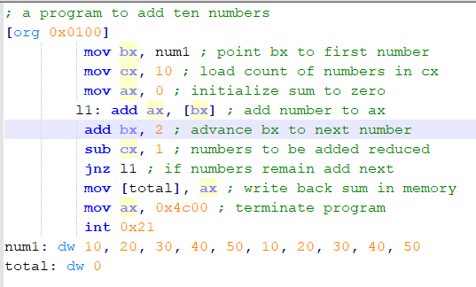
Example
Things to Note:
L1 is code label. Again it is just an address.
Assemble will treat code label in same way as data label.
Every where L1 occurs in code, assemble will convert it to address
Jnz will uze the zero flag to make a decision.
Zero flag becomes 0 if result of arithmetic operation was zero.
Why is 2 added in bx?
Notes:
; a program to add ten numbers
[org 0x0100]
mov bx, num1 ; point bx to first number
mov cx, 10 ; load count of numbers in cx
mov ax, 0 ; initialize sum to zero
l1: add ax, [bx] ; add number to ax
add bx, 2 ; advance bx to next number
sub cx, 1 ; numbers to be added reduced
jnz l1 ; if numbers remain add next
mov [total], ax ; write back sum in memory
mov ax, 0x4c00 ; terminate program
int 0x21
num1: dw 10, 20, 30, 40, 50, 10, 20, 30, 40, 50
total: dw 0

Slide 35
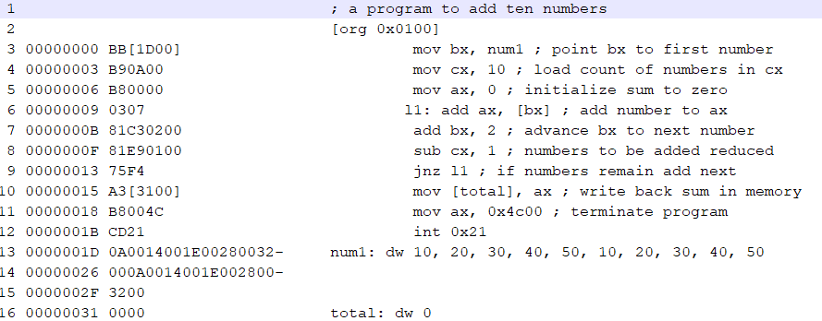
Example (listing file)

Slide 36
Combination of Direct and Indirect Addressing
Direct and indirect addressing modes can be using in combination.
Some examples are
Mov ax, [num1+bx]; where bx contains the offset
Mov ax, [bx+300]; indirect addressing with offset
Mov ax, [bx+si];

Slide 37
ADDRESSING MODES SUMMARY
Direct
Direct + offset
Indirect
Based Register Indirect (e.g. [BX] or [BP])
Index Register Indirect (e.g. [DI] or [SI])
Based Register Indirect + offset (e.g. [BX+100] or [BP+200])
Index Register Indirect +offset (e.g. [SI+100] or [DI+200])
Base + index (e.g. [BX+SI])
Base + index + offset (e.g. [BX+SI+300])
Things that are not allowed:
Base register + base register (e.g [BS+BP])
Index register + index register (e.g. [SI+DI])
Base – index (e.g. [BX-SI])
Part of register cannot be used to access memory address (e.g [BH] or [BL])

Slide 38
Important thing to remember
Programmer has a full control of memory.
If you write any (valid) 16 bit address in square brackets you will be able to access it , either its in form of label/registers +/- offset or simple constant number.
It is up to you to access it carefully without creating logical errors

Slide 39
Reading
BH 2.1, 2.2, 2.3, 2.4, 2.5

